Slide 1

WYTTLE
Group 9 – COMP2003
Joshua Pinder, Roman Grixti, Alex Banfield, Alex McCormick

Slide 2
Overview
Cross platform mobile application
Peer to peer and peer to mentor connections
Discover professional compatibility
Securely communicate
Token based interaction
Reduce isolation among individuals
Improve professional, personal and academic supports
Provide a safe, structured environment for peer mentoring

Slide 3
Group Roles
Group Roles
Project Lead & Backend Lead
UI/UX Lead/Mobile Developer
Front-end Engineer
Bug Testing & Quality Assurance
Joshua Pinder
Alex Banfield
Roman Grixti
Alex McCormick

Slide 4
Objectives
Develop a functional cross-platform mentoring application
Implement secure user authentication and data protection
Enable peer discovery and real-time messaging
Introduce a controlled token economy for mentoring sessions
Deliver a working prototype that meets academic assessment criteria
Demonstrate scalable and secure system architecture

Slide 5



Architecture
React Native for cross-platform codebase
Expo Go for live development and testing
Supabase for robust and scalable back-end

Slide 6
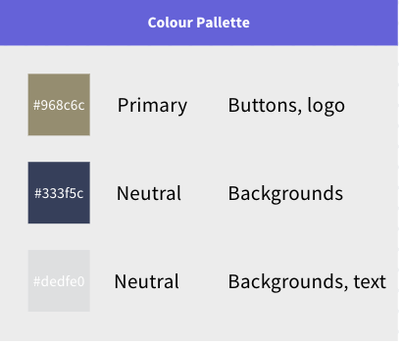
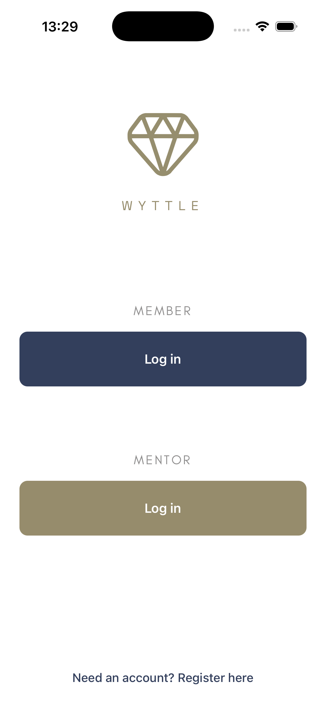
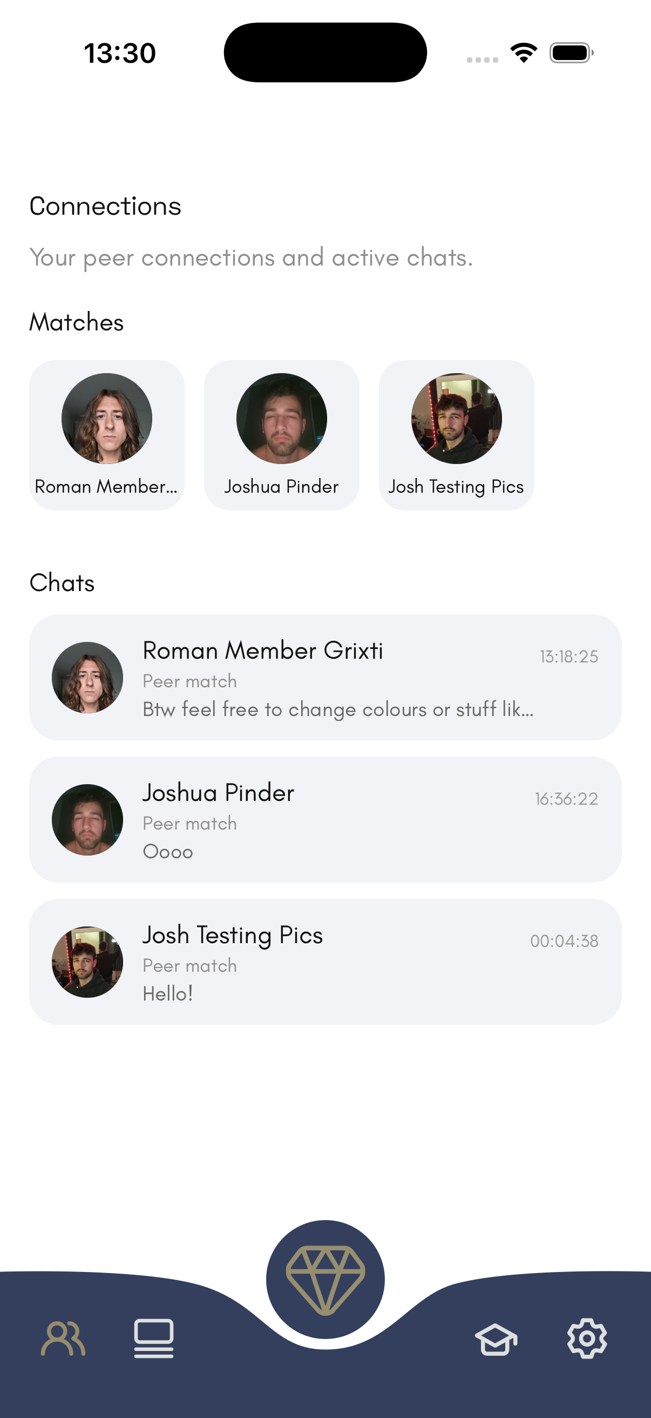
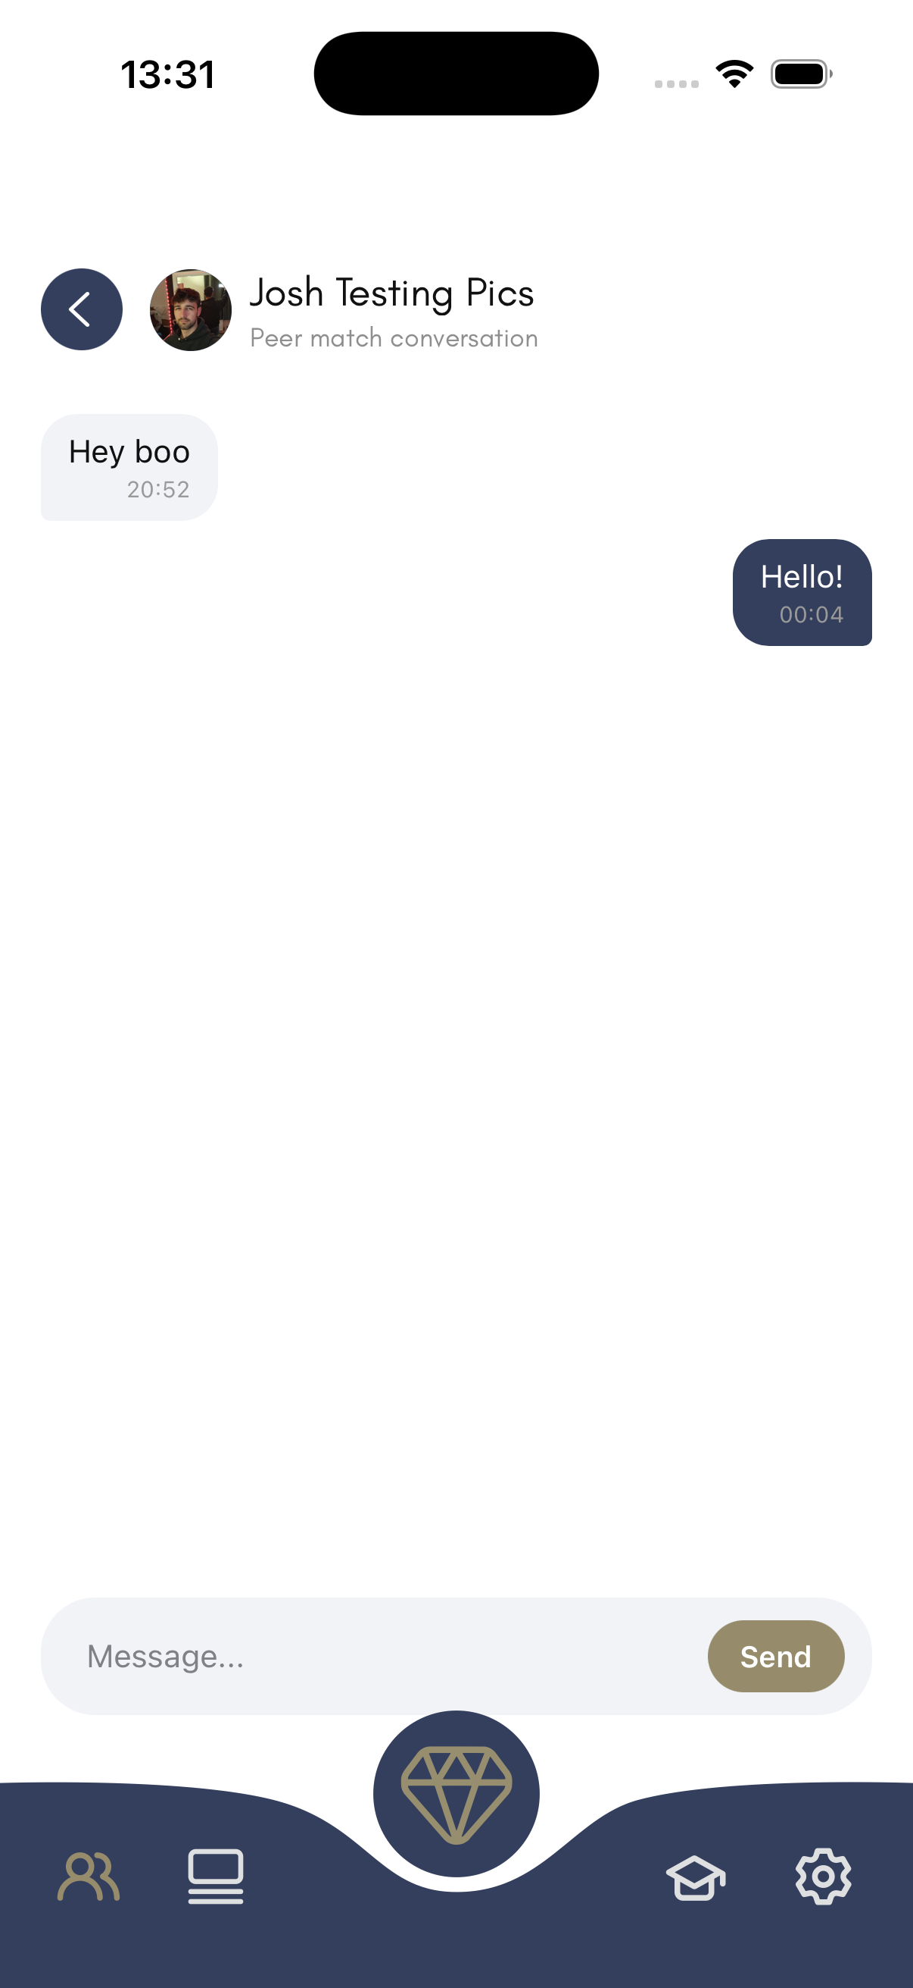
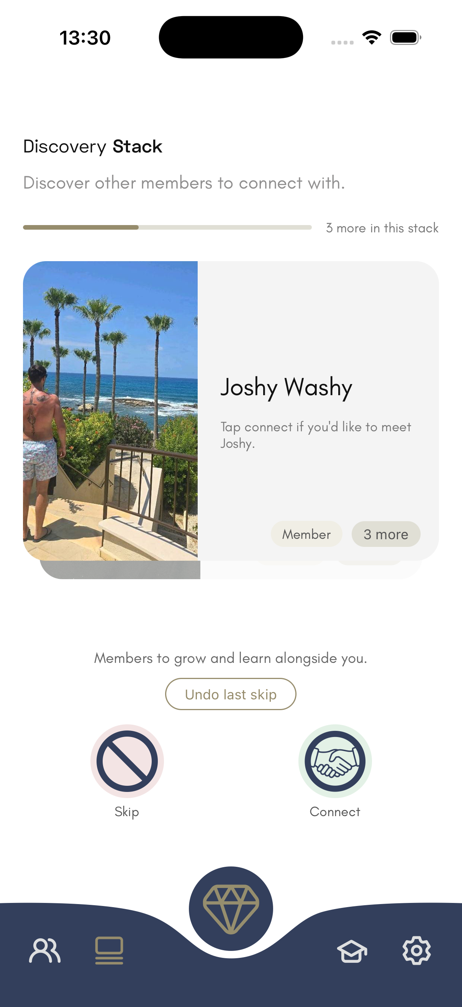
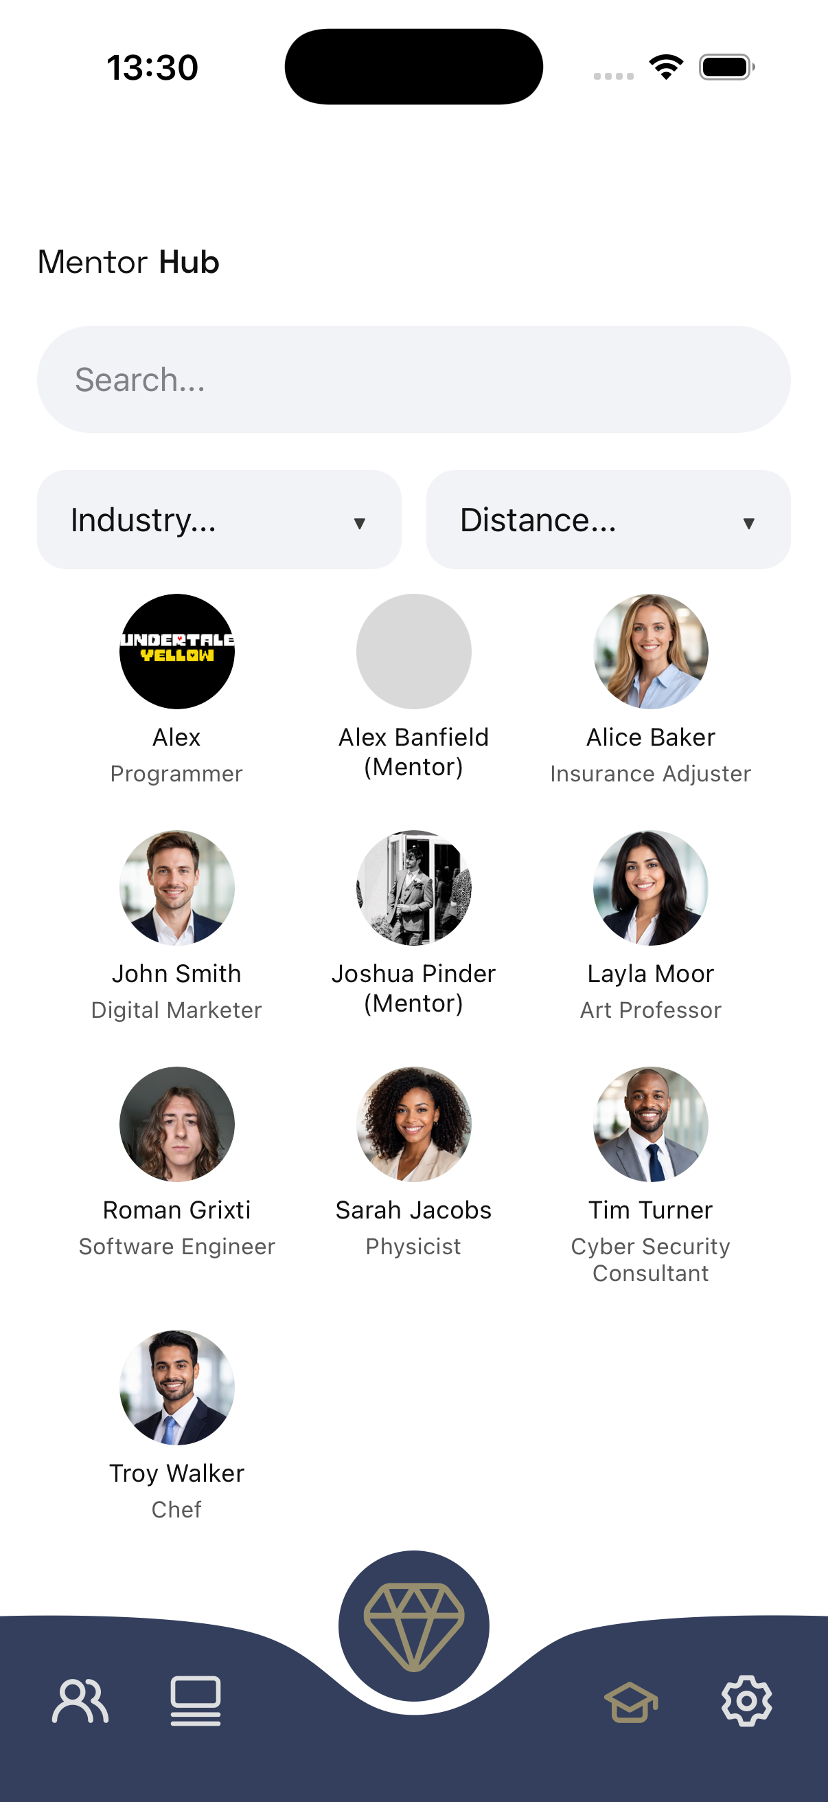


Design
Clear colour palette
Design language applied throughout the app
Consistent design language

Slide 7
Demo

Slide 8
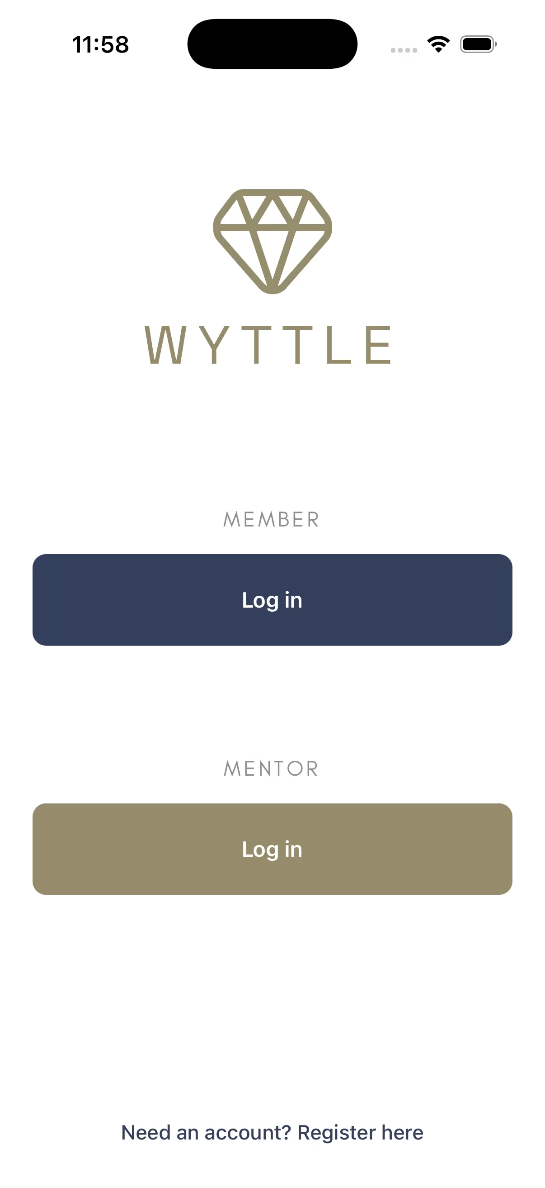

Slide 9

Questions?

Slide 10

Thank you!

